Slide 1
Analyzing Chloride Concentrations in Major Lake Chains of the Twin Cities Metro Area (TCMA)
Anna Curtler and Alexa Chesley

Slide 2
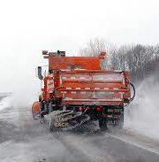
Why study chloride?
Important contaminant in MN – road salt
Estimated ~250k tons of road salt used in the TCMA yearly
Affects Aquatic Life
High levels toxic
Affects water quality
Stratification
Algal blooms
Notes:
Anna

Slide 3
Minneapolis-St. Paul Long Term Ecological Research (LTER)
Researchers from the University of MN, UST, USDA Forest Service, The Nature Conservancy, and Water Bar
Studying how urban stressors affect ecological structure and functioning of urban nature
Well-established data on chloride concentrations in different lakes in the TCMA
Notes:
Alexa

Slide 4
Project Overview
Analysis of LTER chloride data
Temporal Analysis (R)
Expected increasing chloride concentrations over time
Spatial Analysis (ArcGIS Pro)
Expected lakes in watersheds with higher road densities to have higher chloride concentrations
Expected lakes downstream to have increased chloride concentrations
Notes:
Alexa

Slide 5
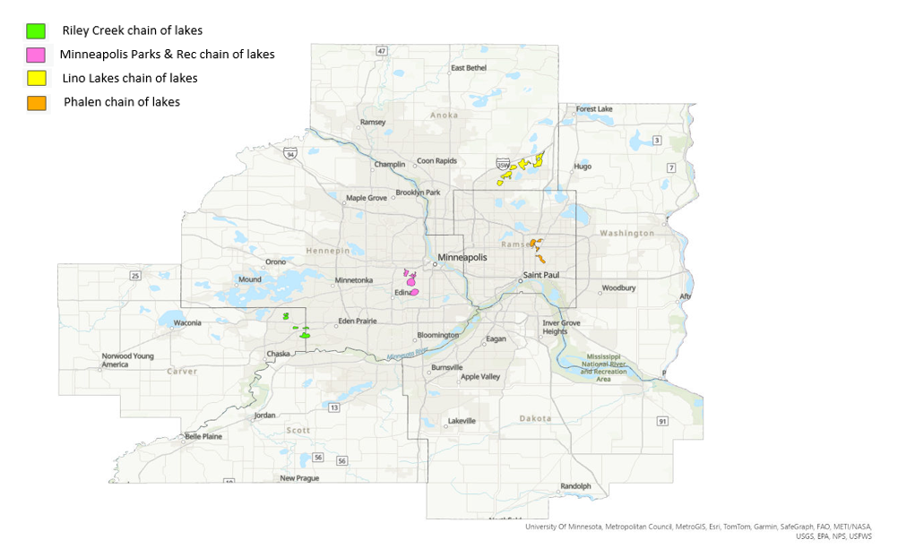
Area of Interest
Notes:
Intro - Anna

Slide 6
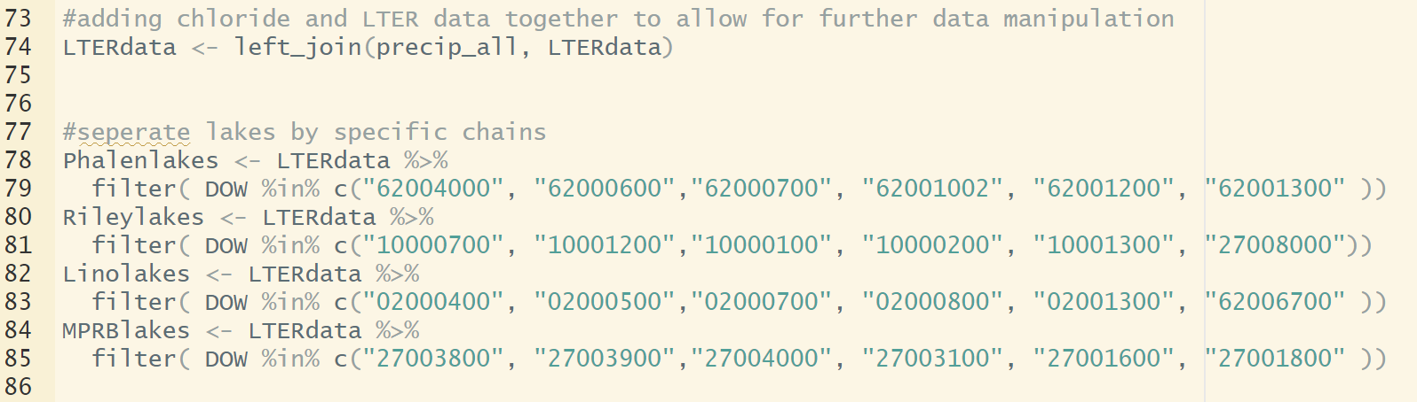
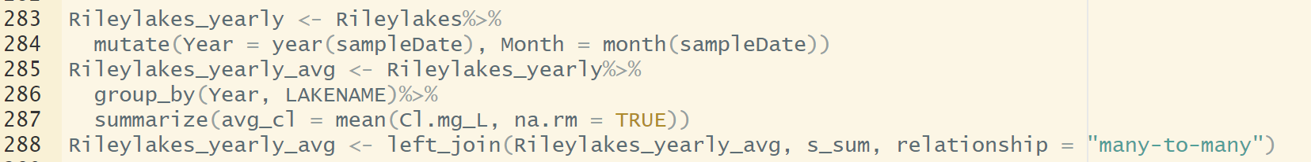
R Methods
Notes:
anna

Slide 7
Temporal Trends
CAN standard for chronic toxicity (120 mg/L)
US standard for chronic toxicity (250 mg/L)
Notes:
Chloride over time - anna

Slide 8
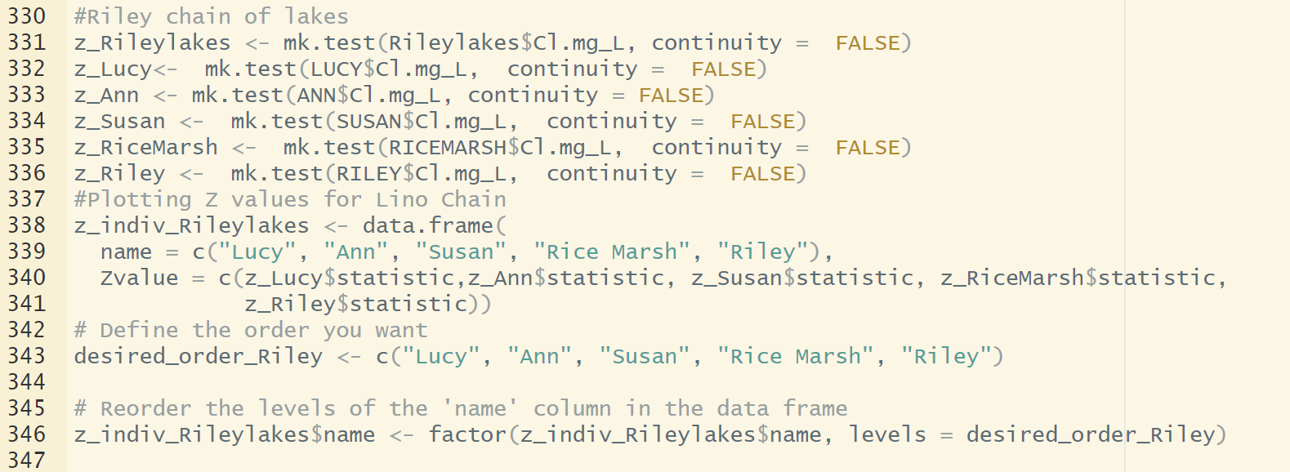
Mann-Kendall For Monotonic Trend
Notes:
alexa

Slide 9
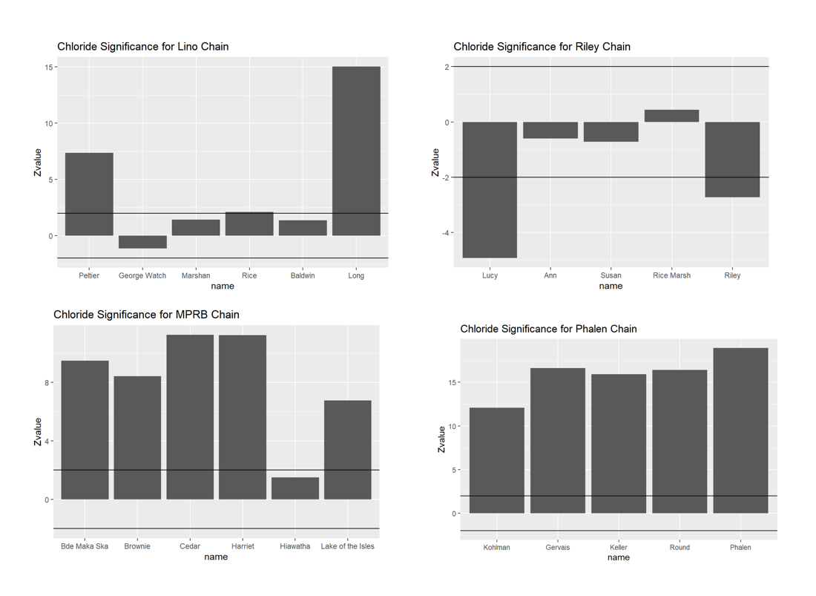
Significant Trends
12 lakes found to have significant increases in [Cl]
2 lakes found to have significant decreases in [Cl]
Notes:
Seasonal kendall test - Significant trends over time - anna

Slide 10
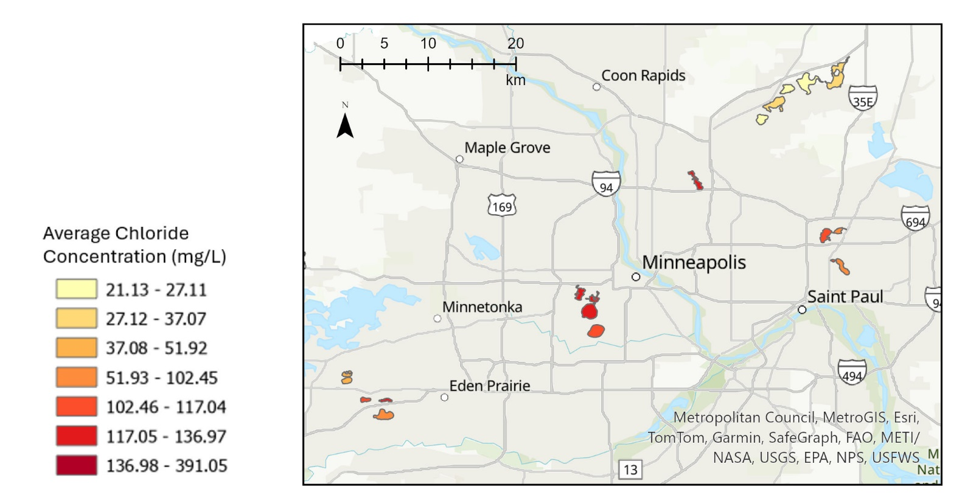
Spatial Distribution of [Cl]
Notes:
Mapped average cl from all data - anna

Slide 11
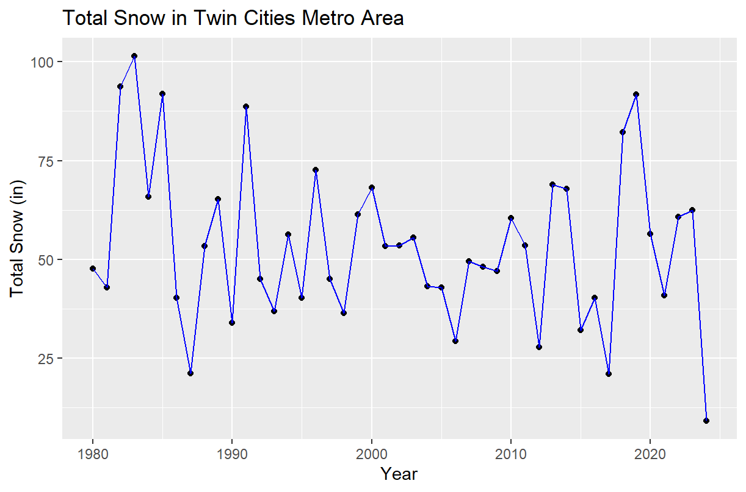
Snowfall in TCMA
No obvious correlation with [Cl] increases
Corroborates complexity in Cl distribution and life cycle
Notes:
Snowfall data – don’t see correlation between peaks and dips of snowfall and Cl. Signifies that chloride concentration is more complicated than road salt application - alexa

Slide 12
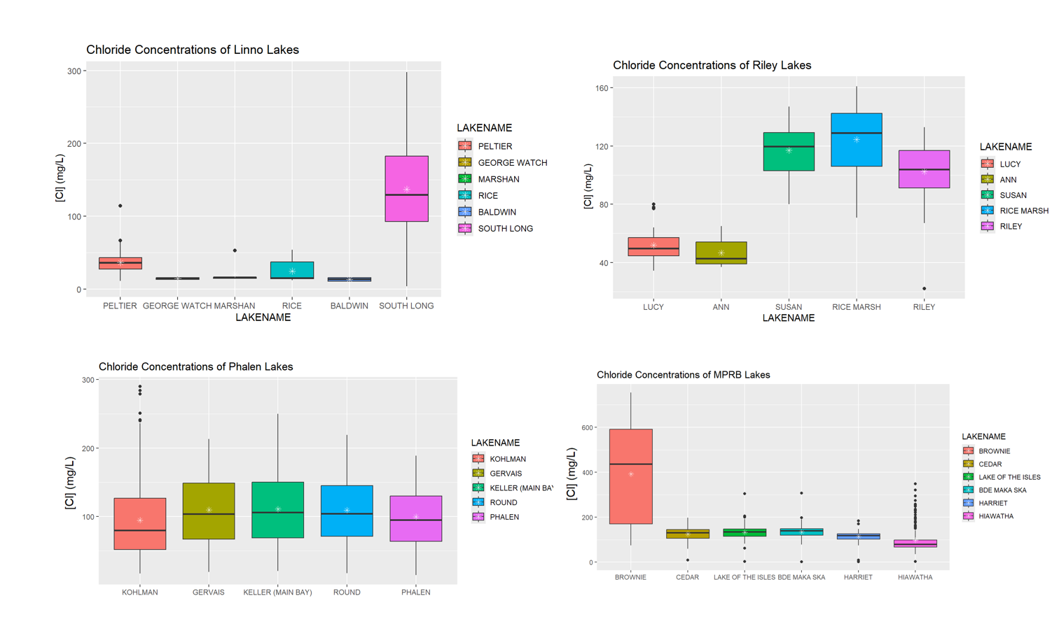
All Examined LTER [Cl] Data
CAN standard for chronic toxicity (120 mg/L)
US standard for chronic toxicity (250 mg/L)
Notes:
Distribution of all chloride values. Shows how lakes and chains differ from year to year - alexa

Slide 13
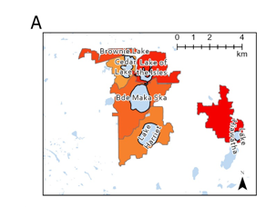
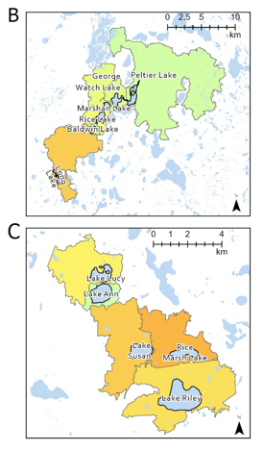
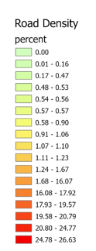
Spatial Distribution of Roads
Lino
MPRB
MPRB was expected to have the highest [Cl] and road density
Higher road density of roads in the Long Lake watershed contributing to Z-score?
Riley
Notes:
Road density - alexa

Slide 14
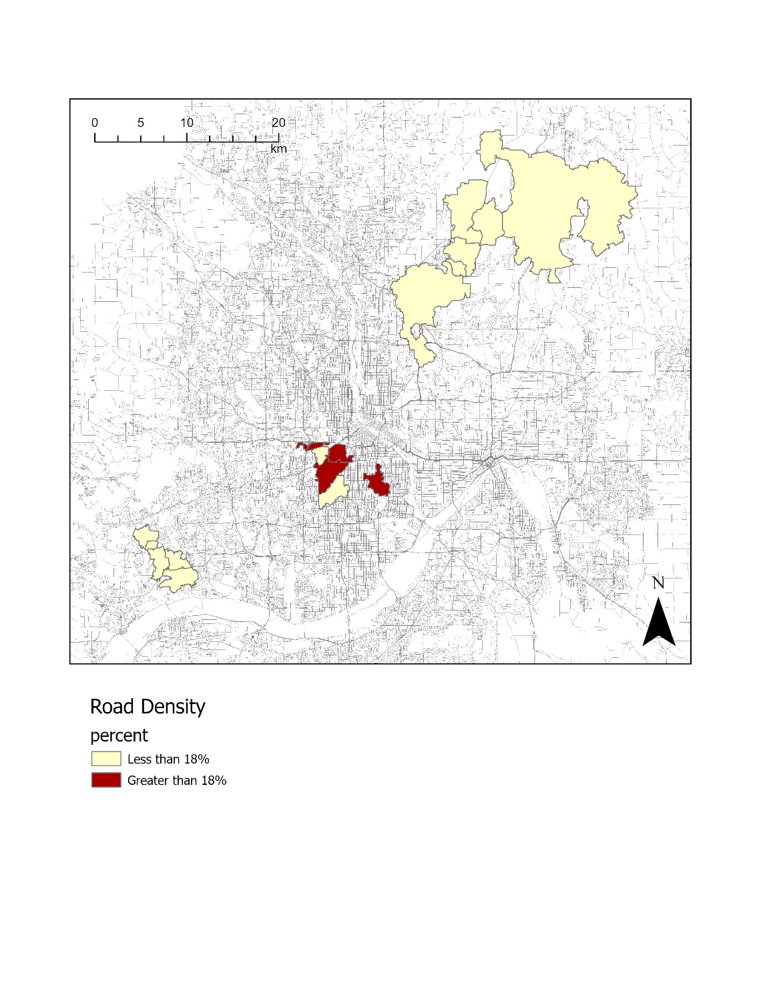
Watersheds with Road Densities >18%
Only 4/7 lakes exhibiting significant increases in [Cl] were found to have road densities >18%
Other factors need to be considered i.e. watershed area
Notes:
alexa

Slide 15
Conclusions
Road density is a factor but not the only indication of a lake at risk for chloride concentration
Snowfall does not correlate with chloride trends
A lake’s watershed area is a bigger factor than the lake’s position in the chain
Notes:
Anna

Slide 16

Questions?

